Slide 1

LF Energy Overview
November 2024

Slide 2
What is LF Energy?
Linux Foundation Energy (LF Energy) is an independent, member-funded non-profit organization whose purpose is to accelerate the energy transition through collaboration on open source technologies and standards.
We are part of the Linux Foundation, the largest shared technology investment in the world.

Slide 3
What is LF Energy?
LF Energy serves as an independent, neutral steward for transparently governed open source technologies and standards that serve as the trustworthy, secure digital foundation for grid modernization and modern energy services.
Supported by 70+ member organizations, 1,000+ contributors from utilities, vendors, research and energy majors collaborate on shared, pre-competitive challenges through 30+ projects.
LF Energy hosts LF Energy Summit, the only conference focused on open source for the digital energy transition.

Slide 4





What does LF Energy do?
Publications, conferences, standards
Publications, conferences
LF Energy complements existing organizations by providing a place to collaborate on open industrial-grade technology platforms and agile specifications.
Open industrial-grade technology platforms and agile specifications
Early-stage research and prototypes
Advocacy for investor-owned electric companies

Slide 5
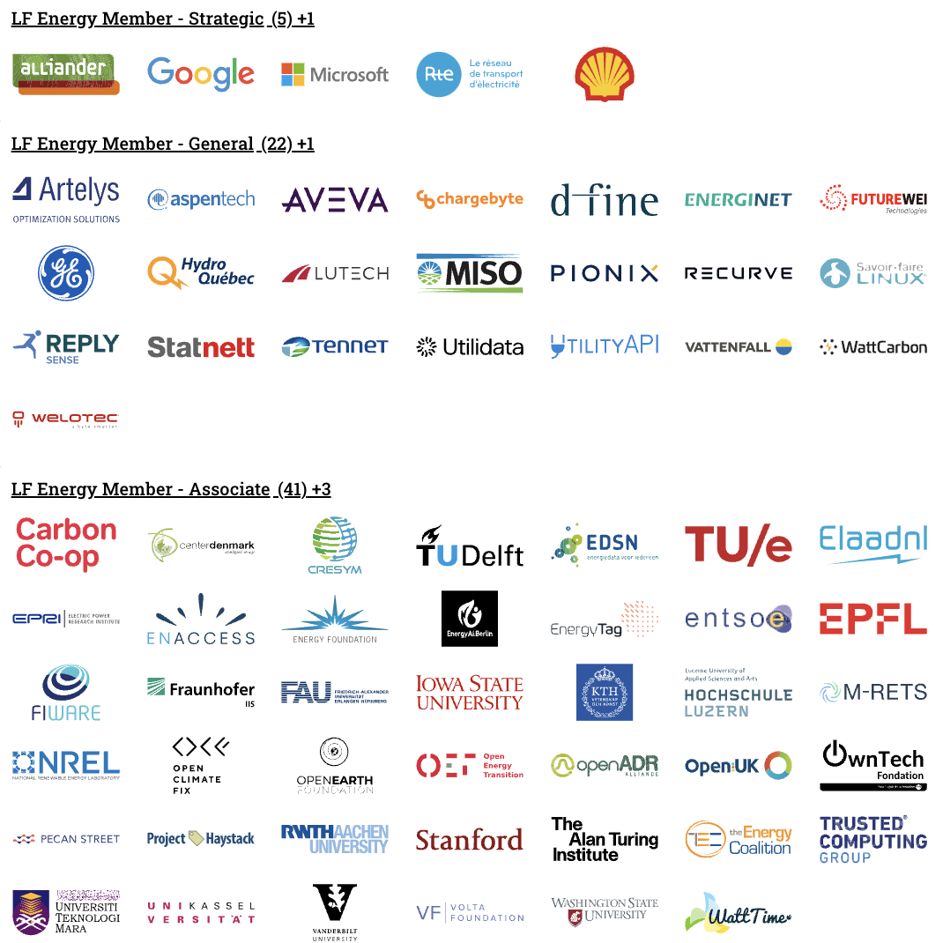
Members
Notes:
Source: https://landscape.lfenergy.org/pages/members?style=%40import%20url%28%27https%3A%2F%2Ffonts.googleapis.com%2Fcss2%3Ffamily%3DRoboto%2BSlab%3Awght%40100..900%26display%3Dswap%27%29%3B%20body%7Bbackground-color:white;font-family:%20%27Roboto%20Slab%27%20!important;%7D.borderless-mode%20.mosaic%20.logo%7Bheight:100px;%7D.sh_wrapper%20span%7Bfont-size:30px!important;text-decoration:underline;color:black;%7D%23embedded-footer%7Bdisplay:none;%7D.borderless-mode%20.mosaic-wrap%20%7B%20padding:%2010px%2020px%7Ddiv%5Bdata-wrapper-id%3Dlf-energy-member-strategic%5D%20.items-cont%3Aafter%7Bcontent%3A%22%20%2B1%22%3B%7Ddiv%5Bdata-wrapper-id%3Dlf-energy-member-general%5D%20.items-cont%3Aafter%7Bcontent%3A%22%20%2B1%22%3B%7Ddiv%5Bdata-wrapper-id%3Dlf-energy-member-associate%5D%20.items-cont%3Aafter%7Bcontent%3A%22%20%2B3%22%3B%7D

Slide 6
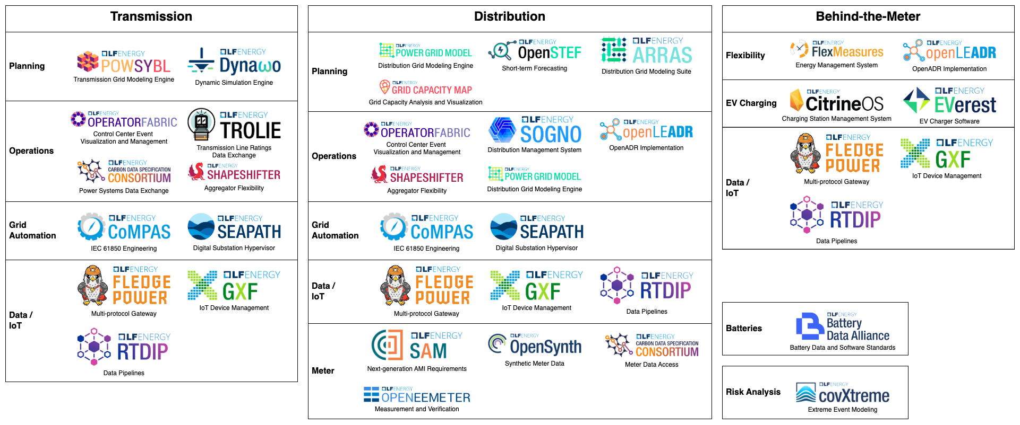
Project Landscape

Slide 7
Membership

Slide 8






Why we joined LF Energy…
“Joining the LF Energy ecosystem will help Hydro-Québec in its innovation process to better respond to the energy transition, while sharing its know-how and expertise with the energy market and helping to decarbonize it.”
“Driven by the needs of the energy transition, our digitalization roadmap is becoming titanic. While traditional software development models are failing to keep pace, being a strategic member of LF Energy has enabled us to pave the way for open source collaborations that meet our challenges.”
“Collaboration and partnerships are central to our digital strategy. As a member of LF Energy, we can expand our open source efforts, leverage the Linux Foundation's expertise in Open Source, and share knowledge and resources across the industry and academia for a greater collective impact.”
“LF Energy has been a huge benefit in supporting the EVerest community with knowledge of open source best practices, legal and marketing support, as well as many exciting networking opportunities in the energy industry.”
“We’re seeing not only from inside but also from people wanting to work for Shell that they want to work in an open source way, they want to work with tools like that, be a part of a community like LF Energy.”
“Simply utilizing open source is not enough. We are committed to actively contributing back, sharing our code with the world, and fostering the growth of the open source landscape. This is why Welotec has joined LF Energy.”

Slide 9
Member Benefits Overview
Anyone can participate in an LF Energy project, but only members get access to…
Access and Networking Access to thought leaders and peers through discounted access and members-only events. | Ecosystem Stability Mitigate risk by financially supporting the open source ecosystem that your organization relies upon, ensuring you can rely on it for decades to come. | Governance & Legal Leverage LF Energy governance and legal support to enable highly regulated entities to safely collaborate in the open. | Marketing Leverage our community and platform to amplify your reach, connecting with customers and collaborators. | Community Growth Scale your R&D investments through collaborators and contributors found through the LF Energy community.
First Mover Advantage Stay on the cutting edge of digital edge transition, seeing and shaping where the market is going. | Leadership Demonstrate market leadership, and actively steer the direction of LF Energy through voting seats on the Governing Board, TAC, and other committees. | Advising Receive white glove partnership from LF Energy staff to reach your digital goals through open source. | Talent Improve access to and retention of talent by demonstrating your support of open source.

Slide 10
Benefit Highlight: Project Formation
“Through a series of sessions working together, LF Energy helped us shape a new project in a way that enables a shared, open foundation with space for partners to cooperate and innovate on top. We see LF Energy membership as a key strategic move to bring some of our projects to next level.”

Slide 11
Benefit Highlight: Legal
“As a highly regulated utility, our legal team approaches new types of collaboration initiatives with caution. Through our partnership with the LF, we were able to connect our legal team with the LF legal team. This collaboration provided our legal team the reassurance and expertise needed, ultimately making our legal team not only comfortable but also enthusiastic about open source. Without the LF's support, we would not have been able to move this quickly and smoothly.”

Slide 12
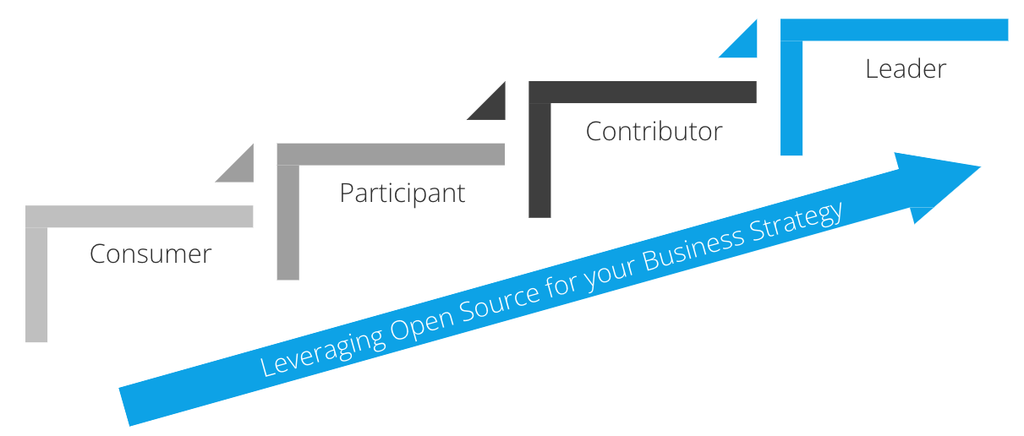
We enable you to become open source leaders

Slide 13
Member Benefits: Leadership
Member Benefits |  | Strategic | General | Non-member
Governing Board seat | Drive the overall Foundation strategy, network with fellow executive leaders in energy | ✓ | Elected (1 seat for every 10 members) | x
Technical Advisory Council seat | Set the technical strategy, guide the project ecosystem | ✓ | Active TSC Chairs | Active TSC Chairs
Advising from LF Energy | Receive custom advising from LFE Executive Director and staff to support your goals | ✓ | Limited | x

Slide 14
Member Benefits: Brand and Marketing
Member Benefits |  | Strategic | General | Non-member
Brand positioning | Have your company recognized as a leader in digital energy technology | ✓ (Top positioning on collateral and dedicated press release upon joining) | ✓ (Positioning on collateral) | x
LF Energy-led co-marketing | Engage over 6k digital energy transition technologists through our blog, webinars, newsletter and case studies | ✓ | ✓ | x

Slide 15
Member Benefits: Events
Member Benefits |  | Strategic | General | Non-member
Members-only Meetings | Exclusive member-only events and roundtables where members explore new opportunities and existing projects | ✓ | ✓ | x
LF Energy Summit | Only industry event at the cross section of energy, open source and tech, providing unparalleled content and networking. | ✓ Discounted Access (unlimited) | ✓ Discounted Access (unlimited) | Full price
 |  | Speaking Preference Preference given to members and LFE projects. | Speaking Preference Preference given to members and LFE projects. | Submit speaking requests through standard CFP

Slide 16
Member Benefits: Training
Member Benefits |  | Strategic | General | Non-member
Linux Foundation Training and certifications | LF Energy members enjoy premium access to LF Open Source Training and Certification | ✓ 50-seat, annual subscription granting access to our library of eLearning courses and certification exams | ✓ 10 complementary LF Training course / certification tickets | Full price

Slide 17
Membership Tiers
Strategic
$150k / year
Organizations that want to demonstrate market leadership and directly influence the future of digital energy.
General
$5-50k / year
Fees scale based on # of employees
Organizations that want to amplify their impact and accelerate the energy transition.

Slide 18
Linux Foundation Member Benefits
All LF Energy members must also become members of the Linux Foundation at any tier (more information here). Some of the benefits your organization can take advantage of by being an LF member include:
Legal Conferences. Join exclusive legal conferences including the annual LF Legal Summit, LF Open Compliance Summit, legal tracks at the Open Source Leadership Summit, and access the bimonthly legal counsel calls. Ad-hoc support. Engage with our open source compliance experts for ad hoc discussions ranging from potential new projects to internal program office structures and processes. | Strategic Guidance Best Practices. Opportunity for your open source program office to participate in the TODO Group (todogroup.org) and Open Source Security Foundation (OpenSSF). Introductions to other Linux Foundation members and hosted projects of interest to expand business opportunities | Insights Leverage LFX Insights to validate projects for investment, and track the activity and growth of projects you’re already involved in. Gain visibility on your project’s code pipeline and performance metrics. Ensure the health & viability of the open source projects you care about. Showcase your organization’s leadership and subject matter expertise in the open source community
Events Discounts for Linux Foundation Events Access to exclusive, member-only events like the LF member summit | Training Discounts. Access discounted LF Training & Certification offerings. Check out the LF Course Catalog and use the quote tool to obtain your discounts. Platinum ONLY. Enterprise wide license to Open Source Management and Best practices curriculum | Marketing Lead sponsored webinars. Participate in articles and press releases.

Slide 19
Ready to join LF Energy?
Fill out a membership application now

Slide 20




Contact Us
Linux Foundation Energy
548 Market St PMB 57274 San Francisco CA 94104 Phone/Fax: +1 415 723-9709 www.lfenergy.org
General Inquiries
info@lfenergy.org
Membership
membership@lfenergy.org

